Slide 1
The Daher & Khoury family
By Joseph

Slide 2
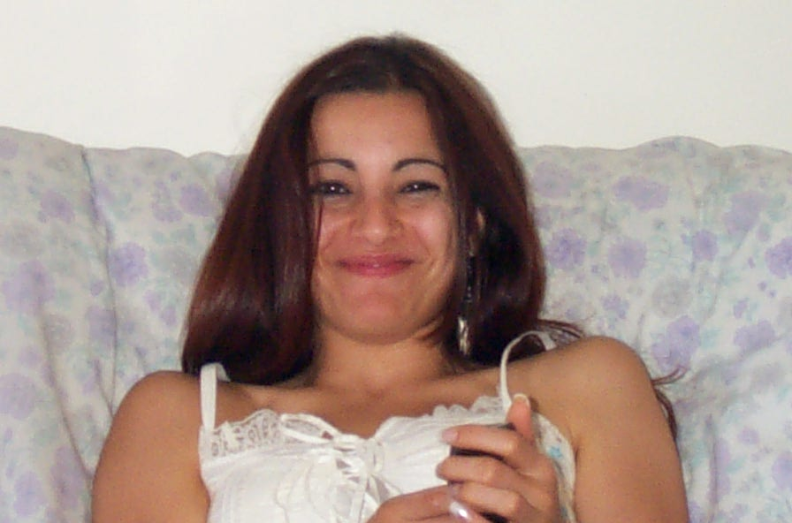
My ugly cousin Chantal

Slide 3
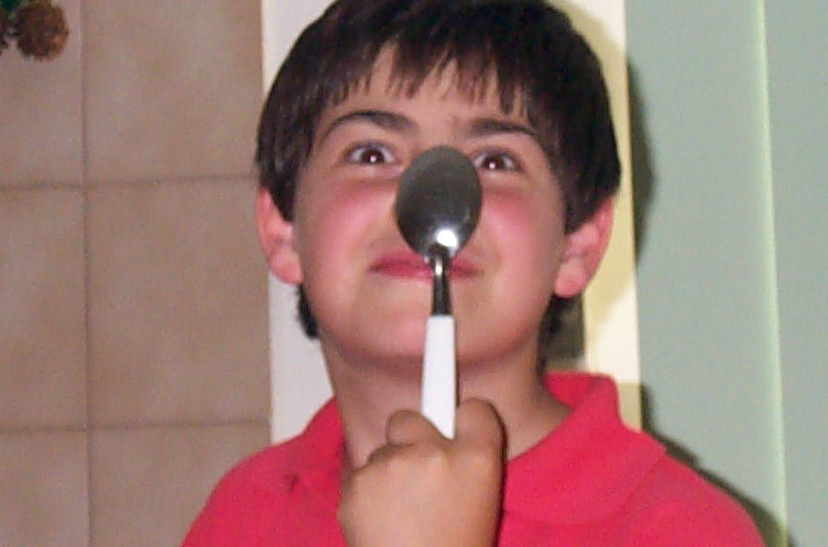
Joseph acting stupid

Slide 4
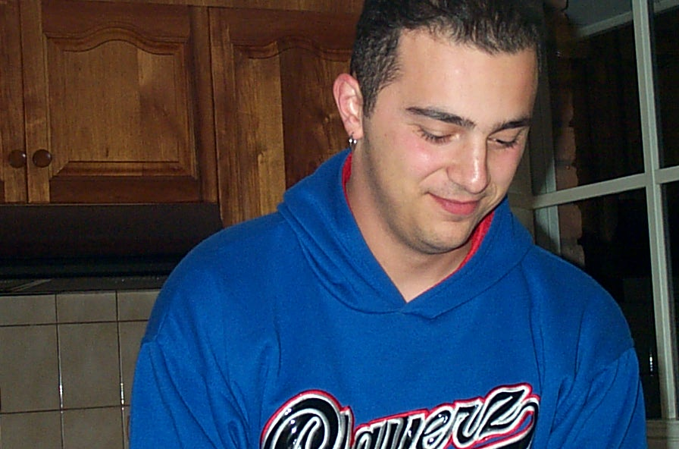
Nadim

Slide 5
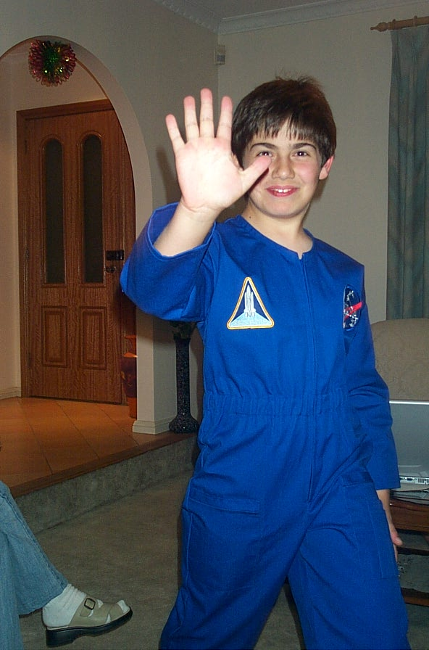
Joseph trying on his Nassar suit

Slide 6
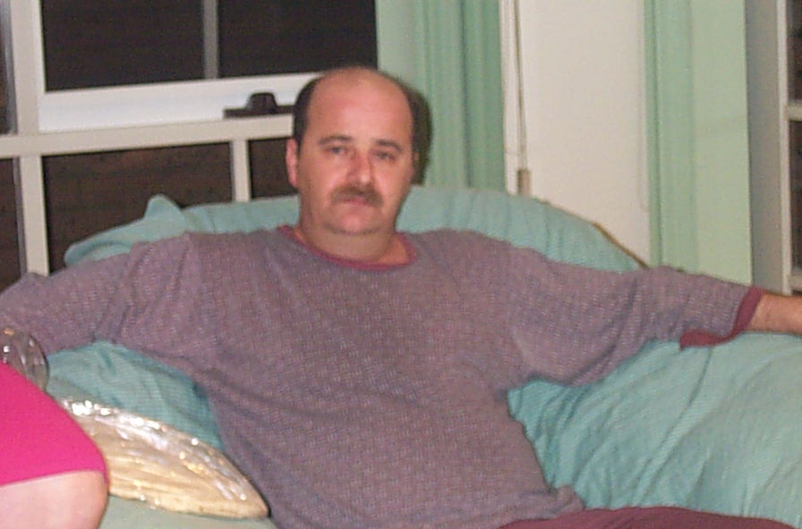
My dad acting Lazy

Slide 7
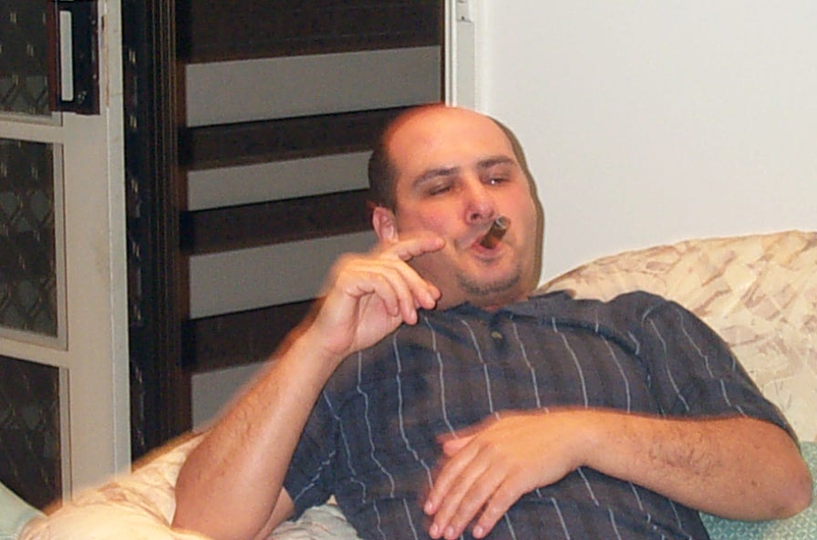
Uncle Freddy smoking

Slide 8
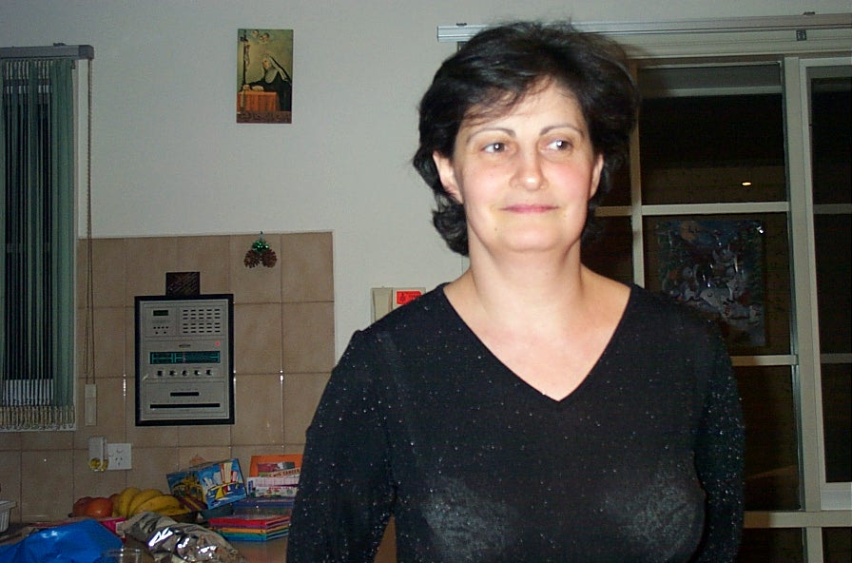
My beautiful mum

Slide 9
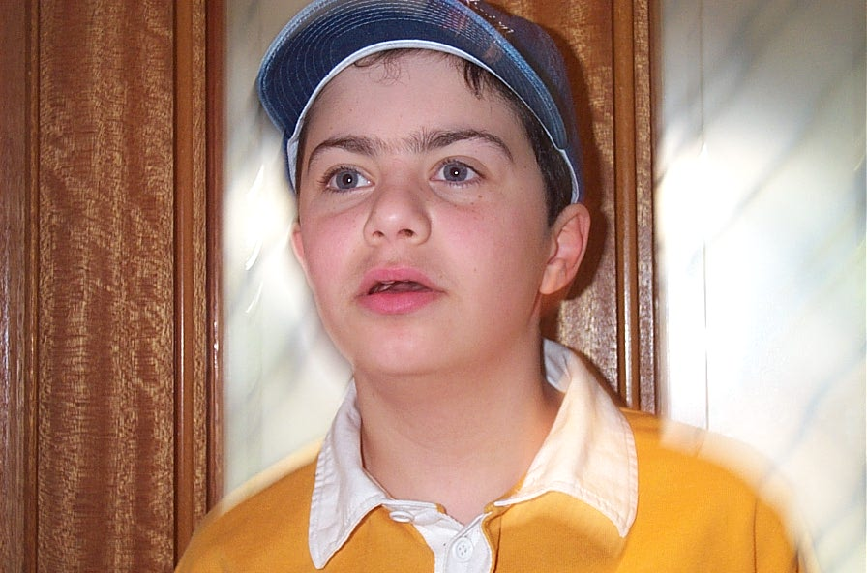
Abraham looking like an angel

Slide 10
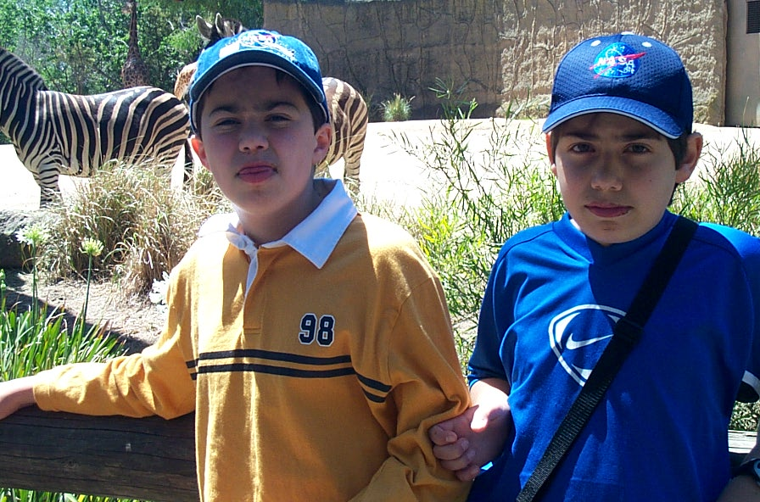
Abraham and Joey at the zoo

Slide 11
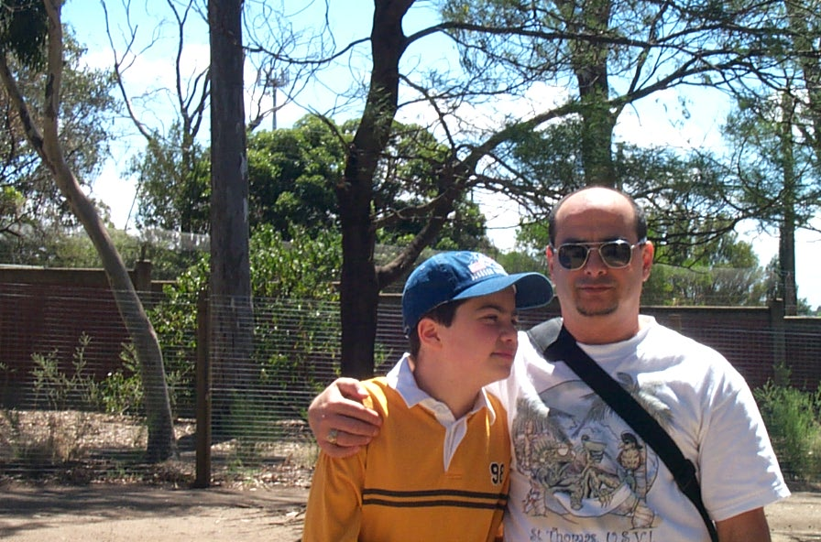
Abraham and Freddy at the zoo

Slide 12
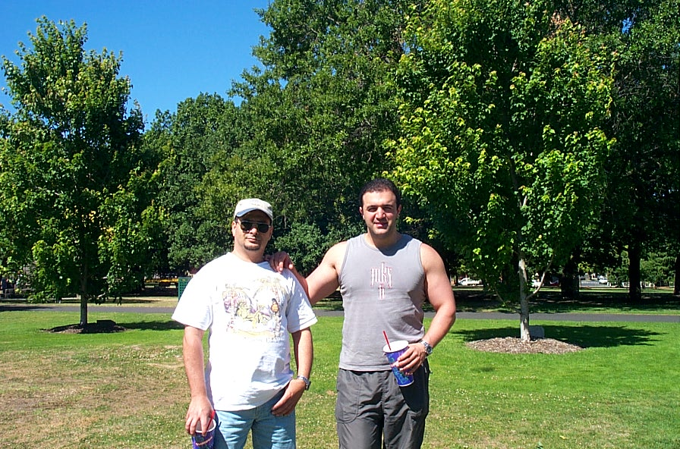
The gay men at Queens park

Slide 13
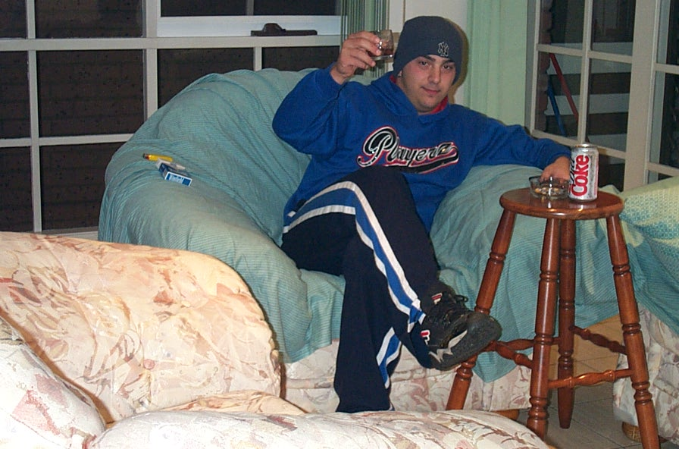
Name: Nadim age: 22 wanted dead or alive

Slide 14
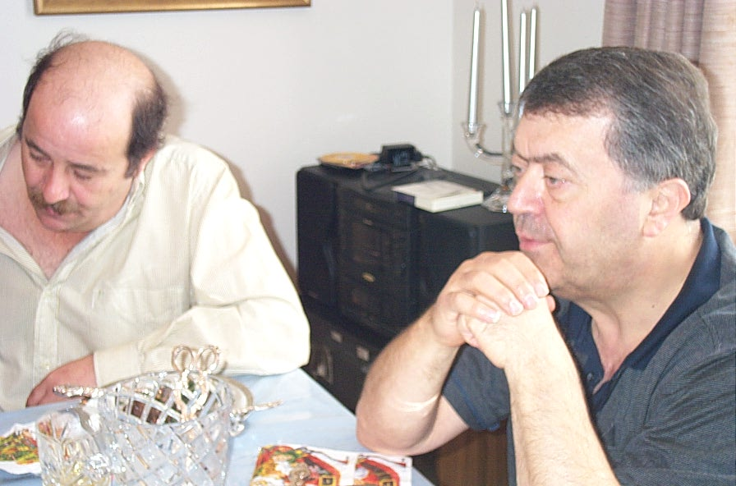
Best friends

Slide 15
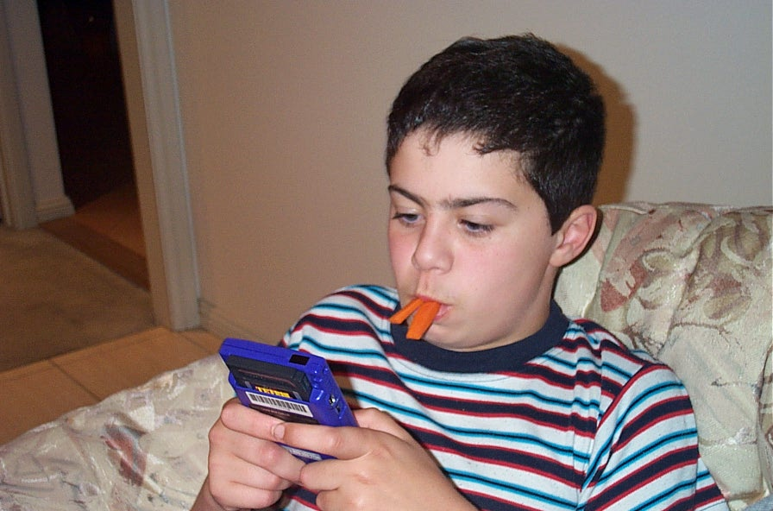
Abraham looking as cute as ever

Slide 16
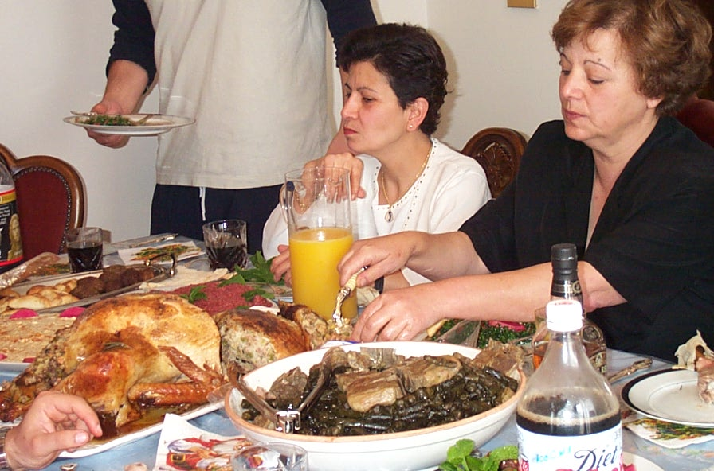
My two Aunties

